Slide 1

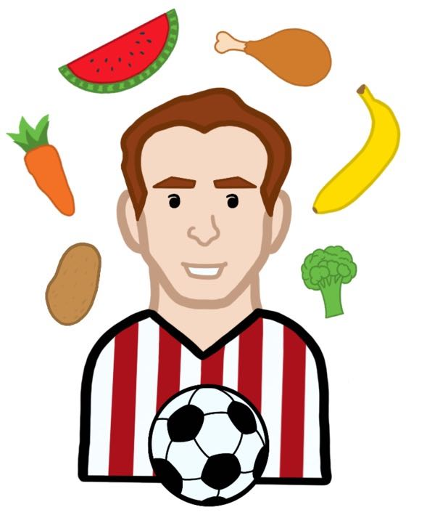


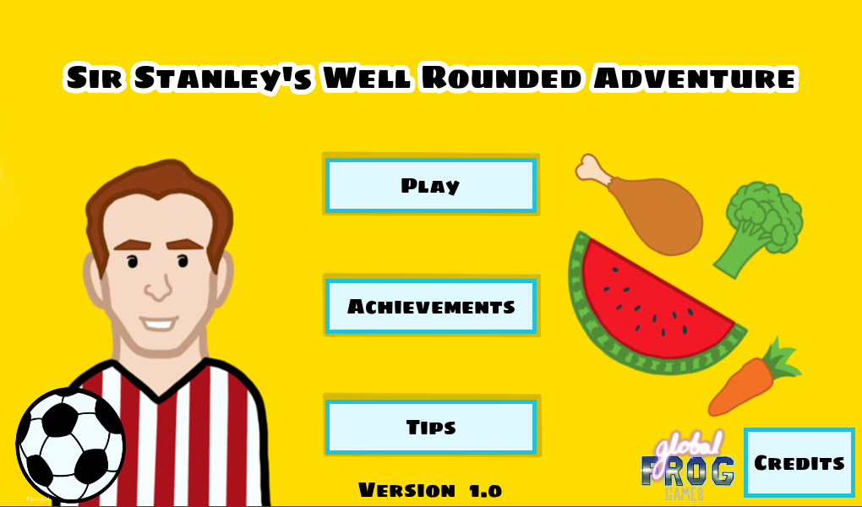
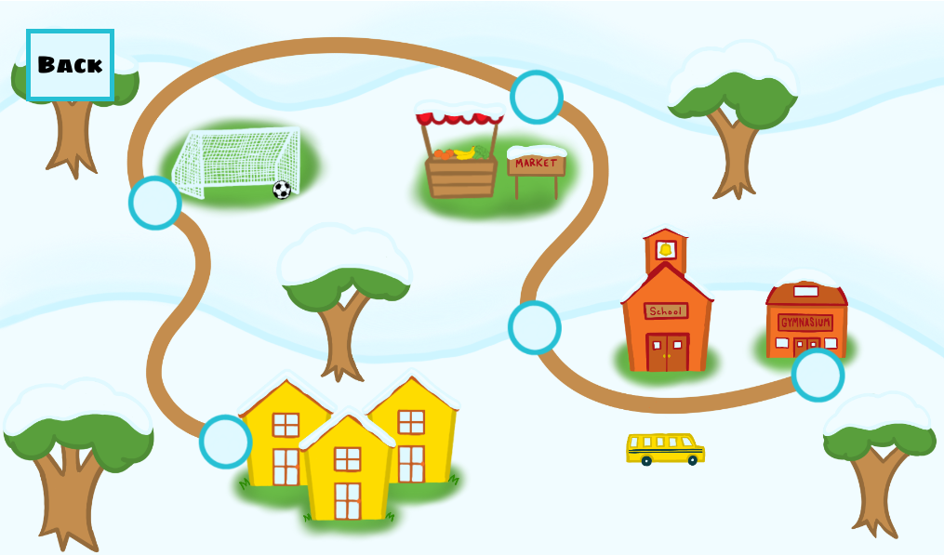
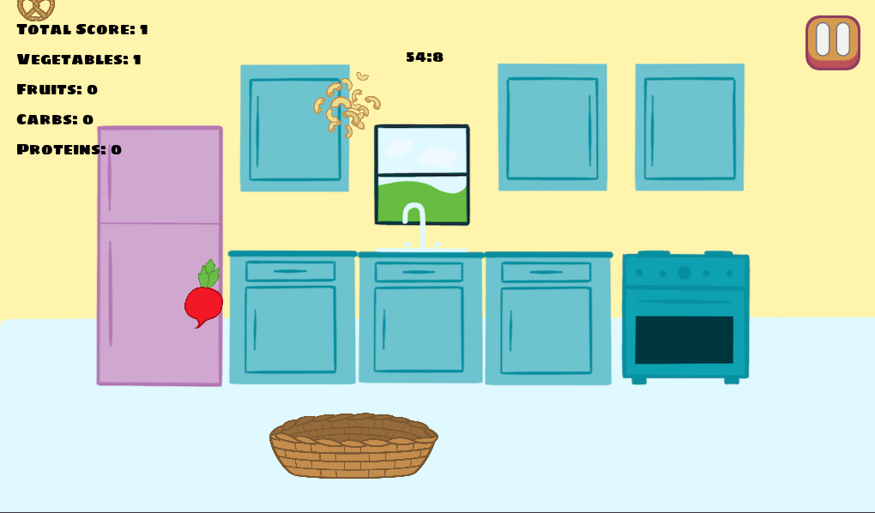
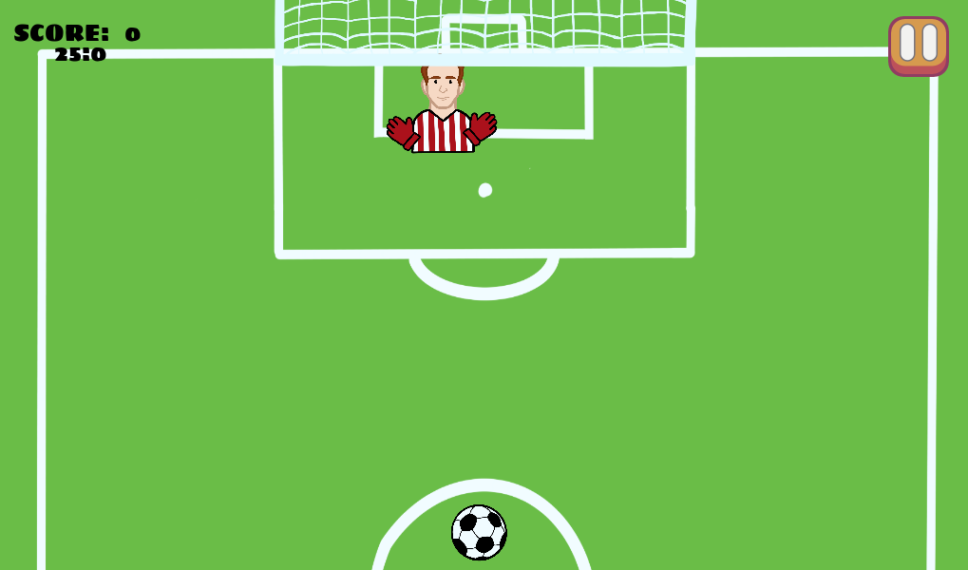
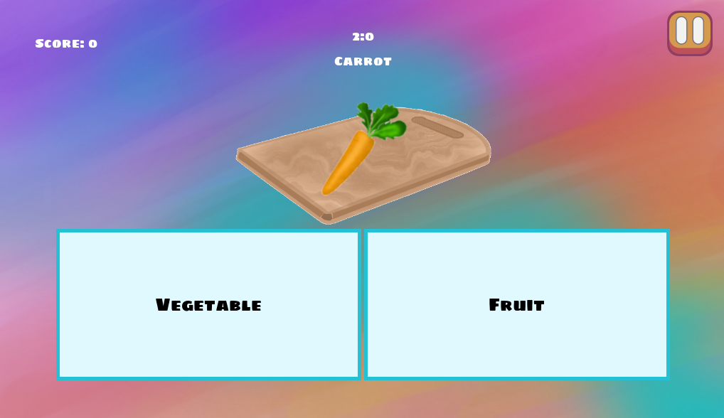
Sir Stanley’s Well Rounded Adventure
Learning to Live a Healthy Life Through A Mobile Game
Brooke Smith, Nick Bonavia, Sellars Levy, Shane Mitchell, Westen Riley, David Rasberry
Faculty Advisor: Michael Scherger Ph.D. (COSC)
Background
Childhood Obesity rates are increasing
Children lack the knowledge for living a healthy lifestyle
Children are less active now than in previous years
We are working with Professor Samantha Davis, a professor in TCU’s Nutrition Department, to create a mobile game that will help educate children on topics like nutrition and physical activity.
Title Screen
Map Screen
Our Solution
Game of minigames
Each minigame focuses on a topic relating to nutrition or physical activity
Each minigame includes a tutorial that will explain how to play and some facts about the topic it relates to
Achievement system will motivate players to play the minigames more than once to help reinforce the information
Tips system will include more in-depth information about the topics (provided by the Nutrition Department)
Falling Food
Goalie Shootout
Our Goal
Educate children about nutrition and physical activity
Make an entertaining mobile game for kids around the ages 6-11
Encourage kids to get active and to make well informed choices with their nutrition
Technologies
Godot and GDScript - Game engine and it’s native programming language.
  Good for cross platform development
JSON - JSON files are used to save data like the highscores and achievements
Procreate for iPad - Art
Github, Slack, and Zoom for collaboration
Initial Solutions
Food and activity tracking app - players would get points for tracking their healthy food decisions and physical activity
A game similar to Pokemon-Go - players would collect healthy foods and vegetables like Pokemon
An RPG (role-playing game) - players would focus on doing quests for various characters with lots of story and dialog.
Stan’s Snacks
Description
Title Screen - The first screen that the player sees when they launch the game.
Map Screen - The screen displayed when the player presses “Play”. This includes navigation buttons to the various minigames.
Falling Food - A minigame about eating balanced meals.
Goalie Shootout - A minigame about pysical activity
Stan’s Snacks - A miinigame about food groups.
References
Godot: https://godotengine.org/
Procreate: https://procreate.art/ipad
Acknowledgements
Thank you to Professor Davis for trusting us with this project. Also thank you to Dr. Scherger and Dr. Wei for guiding us through this project. Finally, thanks to TCU’s Computer Science Department for teaching us valuable information we used throughout our project.

